Slide 1
AIML Classification
Singapore Polytechnic
P2112646
Justin Wong Juin Hng
Singapore Polytechnic

Slide 2
Table of contents
01.
03.
04.
02.
한국 미니멀리스트 스타일의 피치 데크
Problem Breakdown
Modelling & Tuning
You can describe the topic of the section here
You can describe the topic of the section here
Conclusion
Data Manipulation & Exploration
You can describe the topic of the section here
You can describe the topic of the section here
Singapore Polytechnic

Slide 3
01.
Problem Breakdown
한국 미니멀리스트 스타일의 피치 데크
What are the requirements of the problem statement?
Singapore Polytechnic

Slide 4
Problem
Singapore Polytechnic
Build a prediction model in order to predict which machine / component will possibly fail before it actually fails.
This requires us to take into account the different categories and variables to construct a model.
Singapore Polytechnic

Slide 5
02.
Data Manipulation & Exploration
Singapore Polytechnic
Data Cleaning, Feature Engineering and Exploratory Data Analysis (EDA)
Singapore Polytechnic

Slide 6
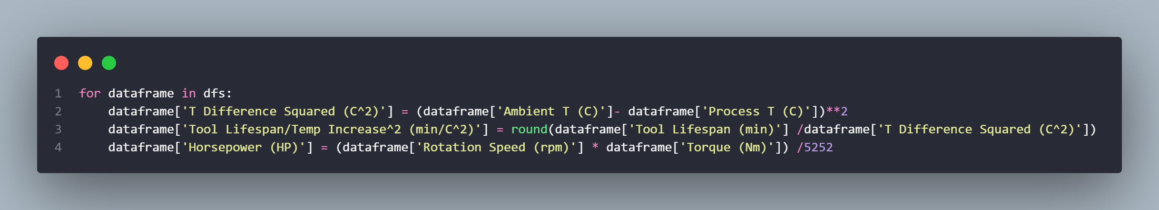
Feature Engineering
Singapore Polytechnic
Creating new features to enhance accuracy of model and increase relevance of data.
The process of designing artificial features into an algorithm. These artificial features are then used by that algorithm in order to improve its performance, or in other words reap better results (Patel, 2021)
Singapore Polytechnic

Slide 7
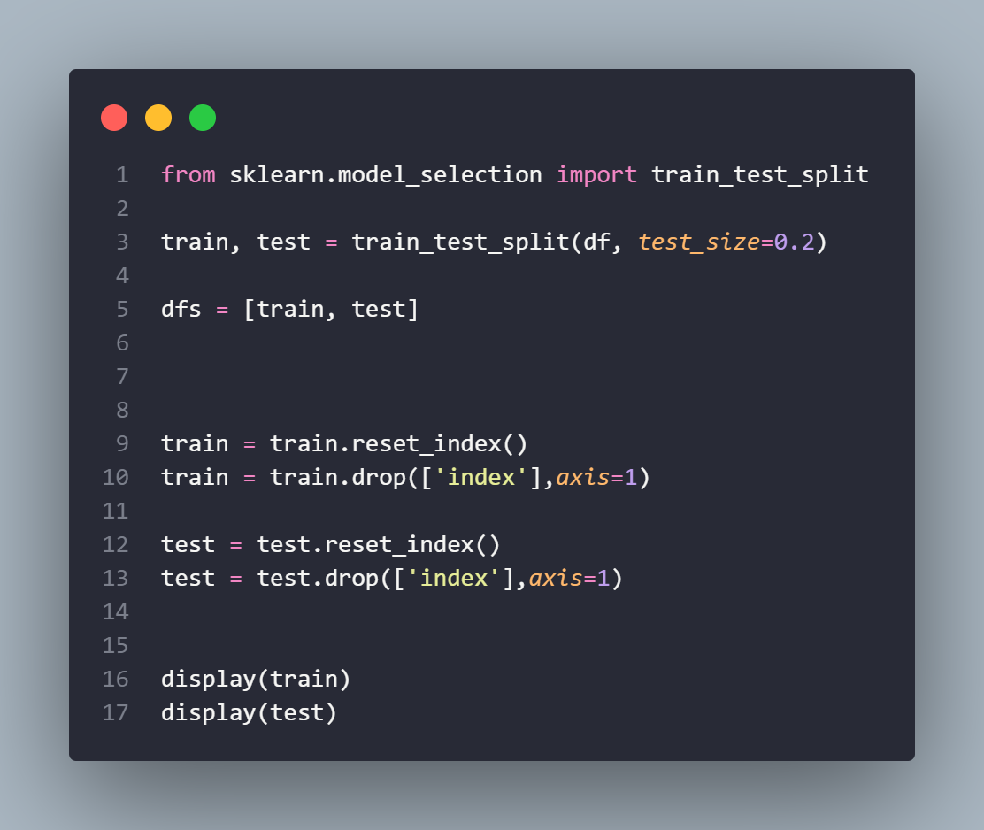
Splitting Data
Singapore Polytechnic
Creating new features to enhance accuracy of model and increase relevance of data.
We split the DataFrame into 2 sets:
Train Data
Test Data
This train-test split procedure is used to estimate the performance of machine learning algorithms when they are used to make predictions on data not used to train the model. (Brownlee, 2020)
Singapore Polytechnic

Slide 8
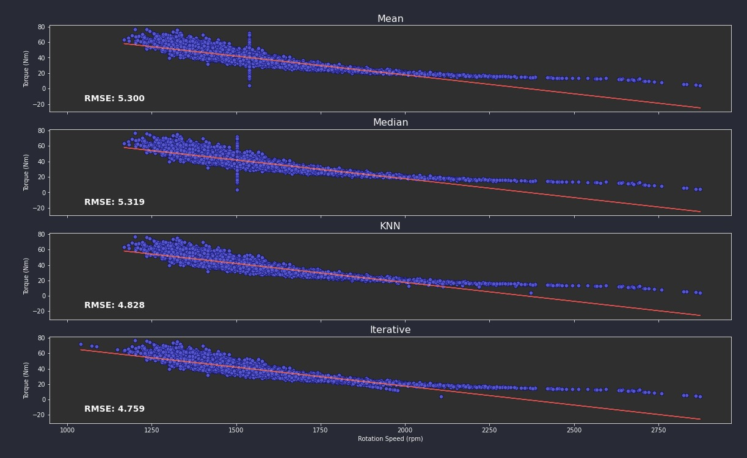
Imputing Data
Singapore Polytechnic
We impute Categorical Data with ‘most_frequent’
Imputing Numerical Data with using different methods found in scikit library
Methods:
Mean Imputation
Median Imputation
kNN Imputation
Iterative Imputation
We can see that Iterative Imputation is the most effective, at an RSME Value of 4.759
Singapore Polytechnic

Slide 9
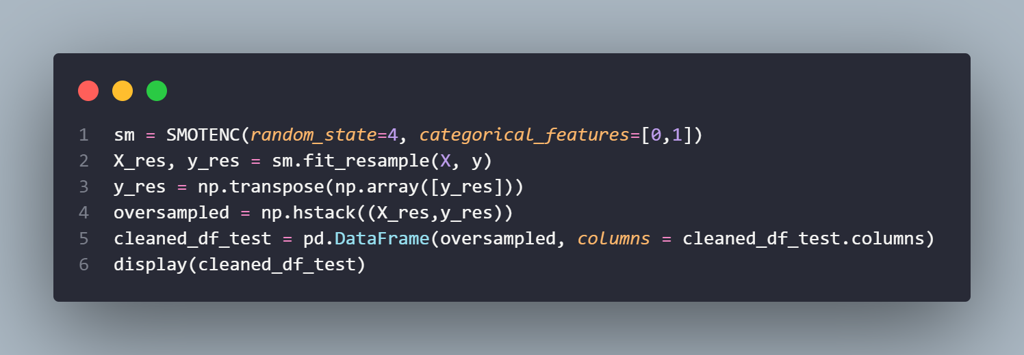
Oversample Data
Singapore Polytechnic
We oversample data to compensate for an imbalance that is either already present in the data, or likely to develop if a purely random sample were taken.
Additionally, we oversample the data to ensure a fair comparison amongst the training and testing data, as there is a 30:1 difference in the number of available training and testing data. This will result in the training and testing being skewed towards encouraging more predictions to be working than broken.
We oversample the data using SMOTENC, a tool generate synthetic data to oversample a minority target class in an imbalanced dataset.
Singapore Polytechnic

Slide 10
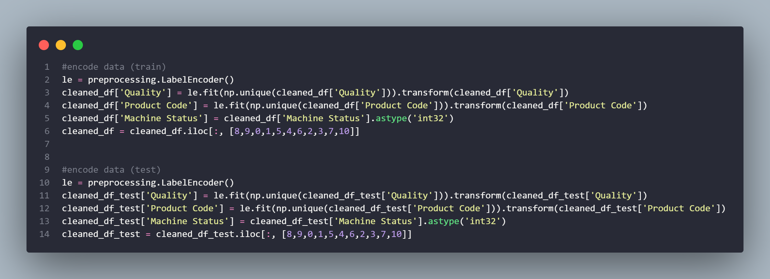
Data Encoding
Singapore Polytechnic
Label encode categorical data as various machine learning algorithms are sensitive when the data is not scaled.
These base concepts are totally based on the mapping of the distance between data points; scaling of the data makes it easy for a model to learn and understand the problem (Verma, 2021)
Singapore Polytechnic

Slide 11
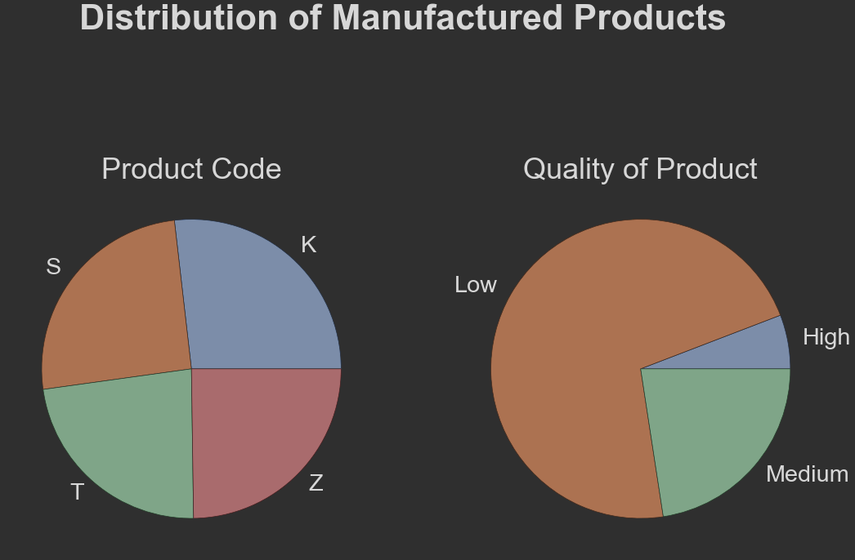
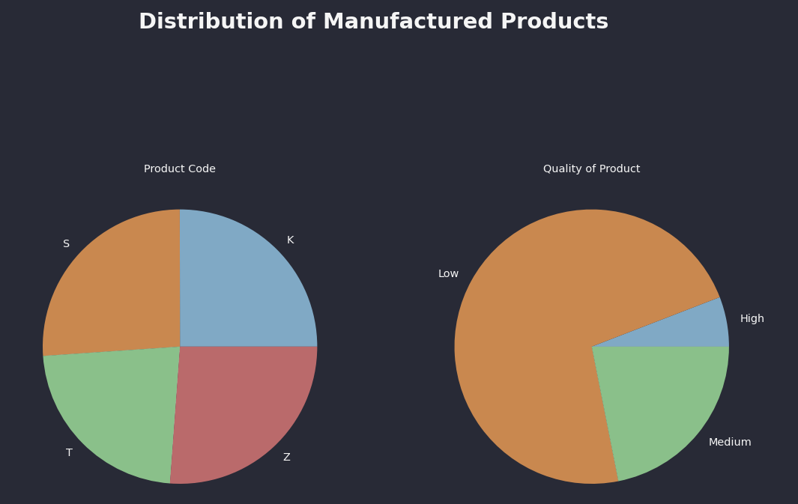
Data Exploration
Singapore Polytechnic
We can see that the distribution of product codes are generally distributed quite evenly, with Product Code T having the smallest number.
One may suggest that if they are all distributed equally, then why do we include it? Well, we do not know the distribution of these product codes with relation to the other columns, and hence, we hold on to the Product Code.
Additionally, we can see that majority of product quality is low, with decreasing counts of medium and high-quality products, respectively.
This suggests that there may be an underlying relationship between quality of product and machine failure rate.
Singapore Polytechnic

Slide 12
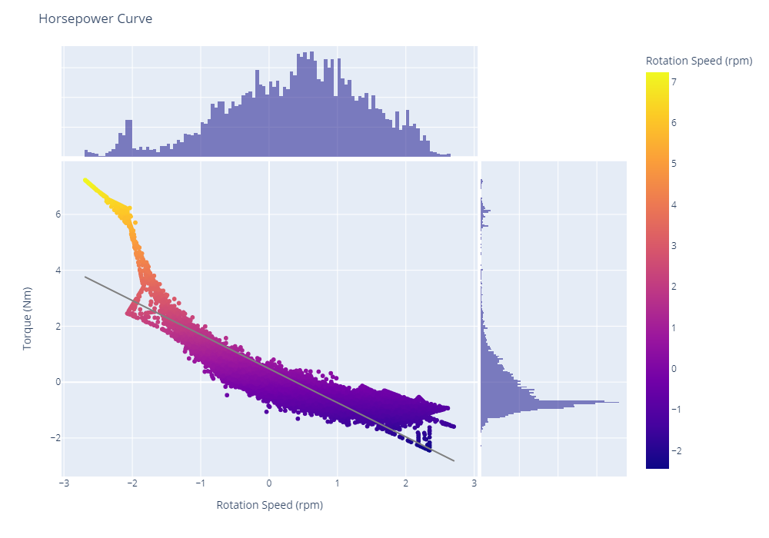
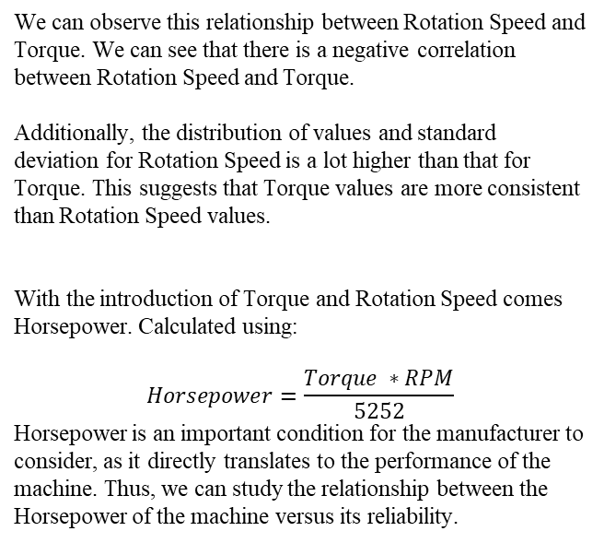
Data Exploration
Singapore Polytechnic
We can observe this relationship between Rotation Speed and Torque. We can see that there is a negative correlation between Rotation Speed and Torque.
Additionally, the distribution of values and standard deviation for Rotation Speed is a lot higher than that for Torque. This suggests that Torque values are more consistent than Rotation Speed values.
With the introduction of Torque and Rotation Speed comes Horsepower. Calculated using:
$$Horsepower=\frac{Torque ∗RPM}{5252}$$
Horsepower is an important condition for the manufacturer to consider, as it directly translates to the performance of the machine. Thus, we can study the relationship between the Horsepower of the machine versus its reliability.
Singapore Polytechnic

Slide 13
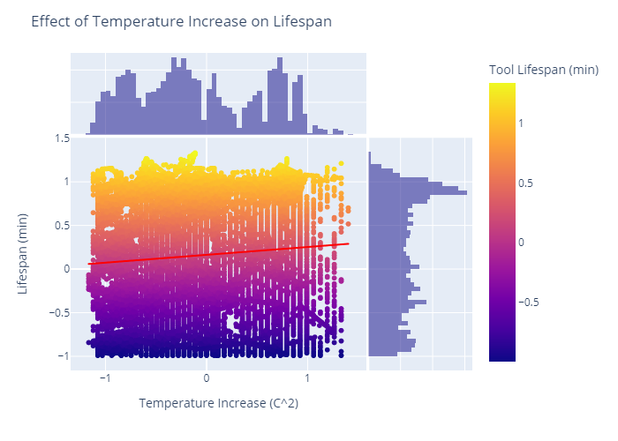
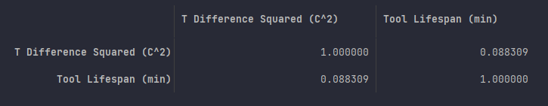
Data Exploration
Singapore Polytechnic
As we can see, the correlation matrix shows us that there is little to no correlation between Tool Lifespan and Temperature Difference, at only 10% correlation.
However, since the correlation is only 10%, we can safely assume that these 2 values are not correlated to a strong extent that might influence the overall machine status
Singapore Polytechnic

Slide 14
03.
Modelling & Tuning
Singapore Polytechnic
Baseline, Initial Modelling and Hyperparameter Tuning
Singapore Polytechnic

Slide 15
Models Used
Singapore Polytechnic
Baseline Model
k-Nearest Neighbours (kNN)
Support Vector Machine (SVM)
Logistic Regression
Gradient Boosting
AdaBoost
Singapore Polytechnic

Slide 16
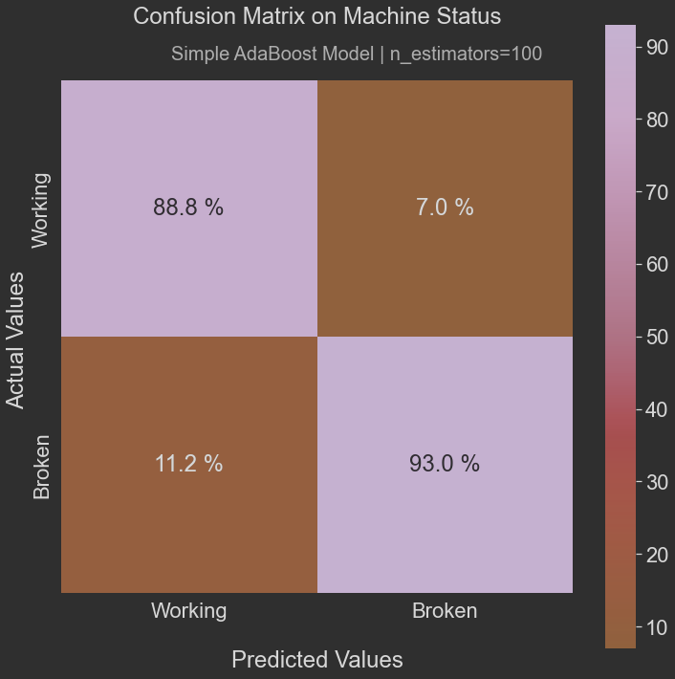
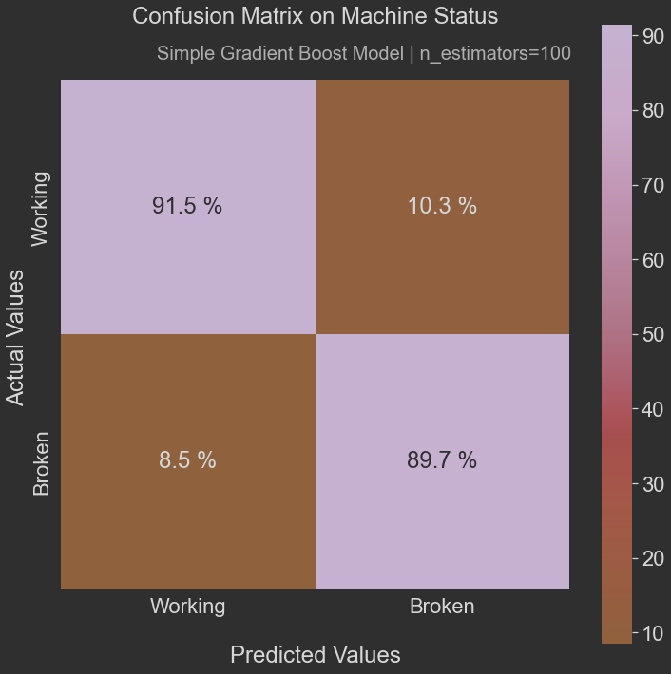
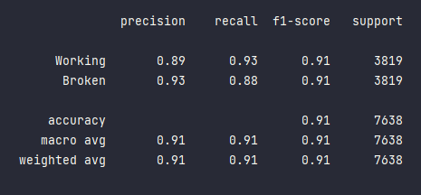
Gradient Boosting
Singapore Polytechnic
From first glance, we can see that the Gradient Boost model is decently effective at detective True Positive Values for Working Machines.
Additionally, we can see that it is also decently effective at detecting True Positive Values for Broken Machines.
This suggests that Gradient Boosting can consistently identify with decent accuracy True Positives and True Negatives.
With an F1-Score of 0.89, it is a strong candidate to proceed to further Model Analysis.
Additionally, Gradient Boost Models offer lots of flexibility - can optimize on different loss functions and provides several hyperparameter tuning options that make the function fit very flexible.
Singapore Polytechnic

Slide 17

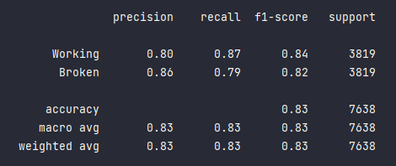
Logistic Regression
Singapore Polytechnic
From first glance, we can see that the Log-Reg model is NOT effective at detective neither True Positive Values for Working Machines nor detecting True Positive Values for Broken Machines.
Since Logistic Regression inherently runs on a linear model, this means even more restriction when it comes to implementing logistic regression, as our dataset is non-linear.
Additionally, Log-Reg is similar to kNN in such a way that Log-Reg can’t handle data with missing values unless you apply a process called imputation.
This means missing values in your data will be filled with certain numerical values such as averages, ones, zeros etc.
This can be a tedious extra task, and it can also introduce wrong bias to the data.
Thus, our F1-Score ends up being similar to that of SVM, at around 0.86, which is also terrible.
Singapore Polytechnic

Slide 18
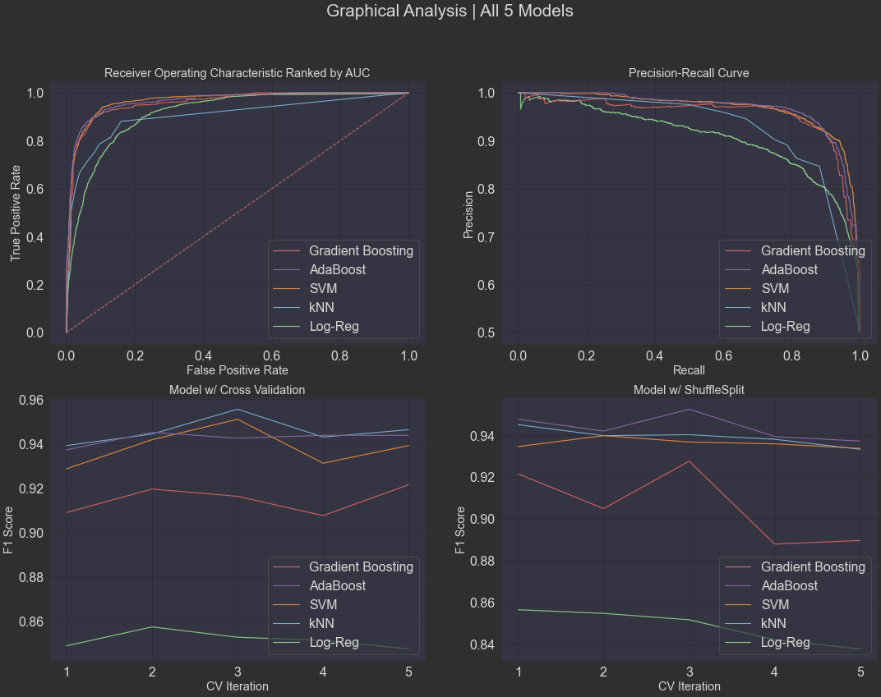
Model Analysis
Singapore Polytechnic
ROC AUC Curve
As we can see, Gradient Boosting and AdaBoost have the 2 highest area below curve
Additionally, we can see that the Logistic Regression has a greater rate of error, since at any given point, the ratio of True Positive to False positive is a lot lower than the other 4 models. This suggests that the Logistic Regression Model is more prone to throwing False Positive Errors
Model w/ ShuffleSplit
For this graph, we can see the different F1 Scores for each model after cross validation. As we can see, kNN and AdaBoost have the 2 highest F1 Scores, but the other 2 Models are also close behind.
Additionally, we can see that the Logistic Regression is just terrible, since for any given CV Value, its F1 Score does not exceed 0.88, whereas the other models’ F1 Scores are all above 0.94. This suggests that the Logistic Regression Model is ineffective even after model cross validation
Singapore Polytechnic

Slide 19
Model Analysis
Singapore Polytechnic
Model w/ Cross Validation
For this graph, we can see the different F1 Scores for each model after cross validation. As we can see, kNN and AdaBoost have the 2 highest F1 Scores, but the other 2 Models are also close behind.
Additionally, we can see that the Logistic Regression is just terrible, since for any given CV Value, its F1 Score does not exceed 0.88, whereas the other models’ F1 Scores are all above 0.94. This suggests that the Logistic Regression Model is ineffective even after model cross validation
Precision-Recall Curve
A Precision-Recall curve shows the relationship between positive predictive value and sensitivity for every possible cut-of. As we can see, Gradient Boosting and AdaBoost have the 2 highest area below curve
Additionally, we can see that the Logistic Regression has a greater rate of error, since at any given point, the ratio of True Positive to False positive is a lot lower than the other 4 models. This suggests that the Logistic Regression Model is more prone to throwing False Positive Errors
Since Gradient Boosting and AdaBoost ranked in the top 2, we will proceed with Gradient Boosting and AdaBoost for Further Hyperparameter Tuning!
Singapore Polytechnic

Slide 20

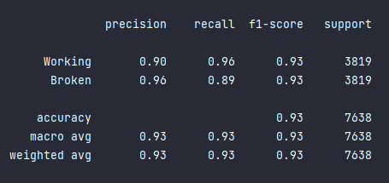
Gradient Boosting (Hyperparameter Tuned)
Singapore Polytechnic
From first glance, we can see that the Gradient Boost model is decently effective at detective True Positive Values for Working Machines.
Additionally, we can see that it is also decently effective at detecting True Positive Values for Broken Machines.
This suggests that Gradient Boosting can consistently identify with decent accuracy True Positives and True Negatives.
With an F1-Score of 0.89, it is a strong candidate to proceed to further Model Analysis.
Additionally, Gradient Boost Models offer lots of flexibility - can optimize on different loss functions and provides several hyperparameter tuning options that make the function fit very flexible.
Singapore Polytechnic

Slide 21
04.
Conclusion
Singapore Polytechnic
Conclusion of Insights
Singapore Polytechnic

Slide 22
Conclusion
Singapore Polytechnic
During hyperparameter tuning we observed that the best model was Gradient Boosting, with:
Recall: 0.93
Precision: 0.93
F1-Score: 0.93
This means that the model can predict Machine Failure with 93% accuracy
Therefore, we can conclude that our model will perform very well when faced with unseen test data.
Singapore Polytechnic

Slide 23
Singapore Polytechnic
Citations
Navas, J. (2022). Anyscale - What is hyperparameter tuning? [online] Anyscale.
Available at: https://www.anyscale.com/blog/what-is-hyperparameter-tuning
[Accessed 16 Jun. 2022].
https://datascience.stackexchange.com/questions/90175/comparing-ml-models-to-baselines
https://www.jstor.org/stable/44547452
Schneider, E.W., Blossfeld, D.H. and Balnaves, M.A. (1988). Effect of Speed and Power Output on Piston Ring Wear in a Diesel Engine. SAE Transactions, [online] 97, pp.1257–1267. Available at: https://www.jstor.org/stable/44547452
[Accessed 9 Jun. 2022].
Singapore Polytechnic

Slide 24
Thanks!
Singapore Polytechnic
Do you have any questions?
youremail@freepik.com
+91 620 421 838
yourcompany.com
Please keep this slide for attribution
Singapore Polytechnic

